Slide 1
Microsoft Bot Framework Cortana HOL
김영욱 부장 Technical Evangelist / CSE
Blog://YoungWook.com
youngwook@outlook.com

Slide 2
Introduce Cortana & Bot Framework
Bot Framework & development tool checking
Hello Bot
Dialog
Card
Text Mining
NLP
Web Chat & Cortana setting
Database connection

Slide 3
Installing Tools
Visual Studio 2019 http://www.visualstudio.com
Get the Visual Studio Bot Project Template http://aka.ms/bf-bc-vstemplate
Get the Bot Emulator https://download.botframework.com/botconnector/tools/emulator/publish.htm
Azure Trial https://azure.microsoft.com/ko-kr/free/

Slide 4
자세한 내용은 Github
http://github.com/KoreaEva/Bot

Slide 5
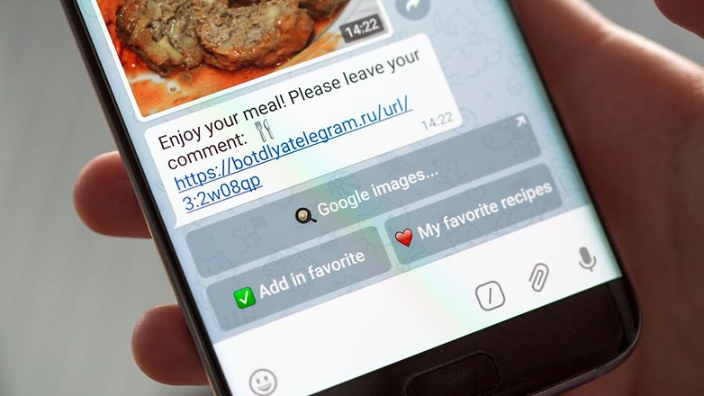
Chatbot Platform

Slide 6
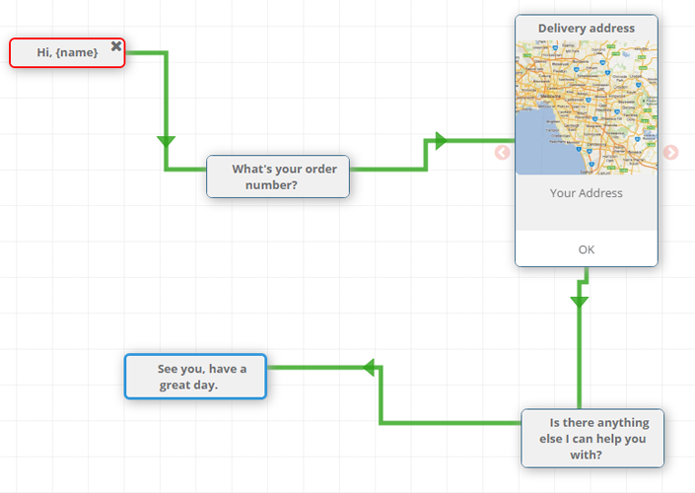
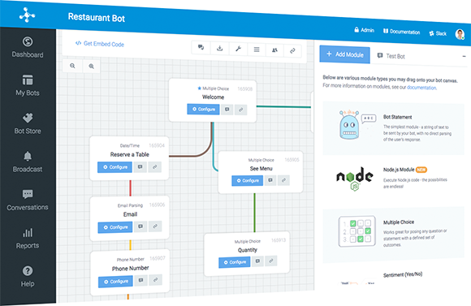
https://www.rebotify.com/
https://www.motion.ai/

Slide 7
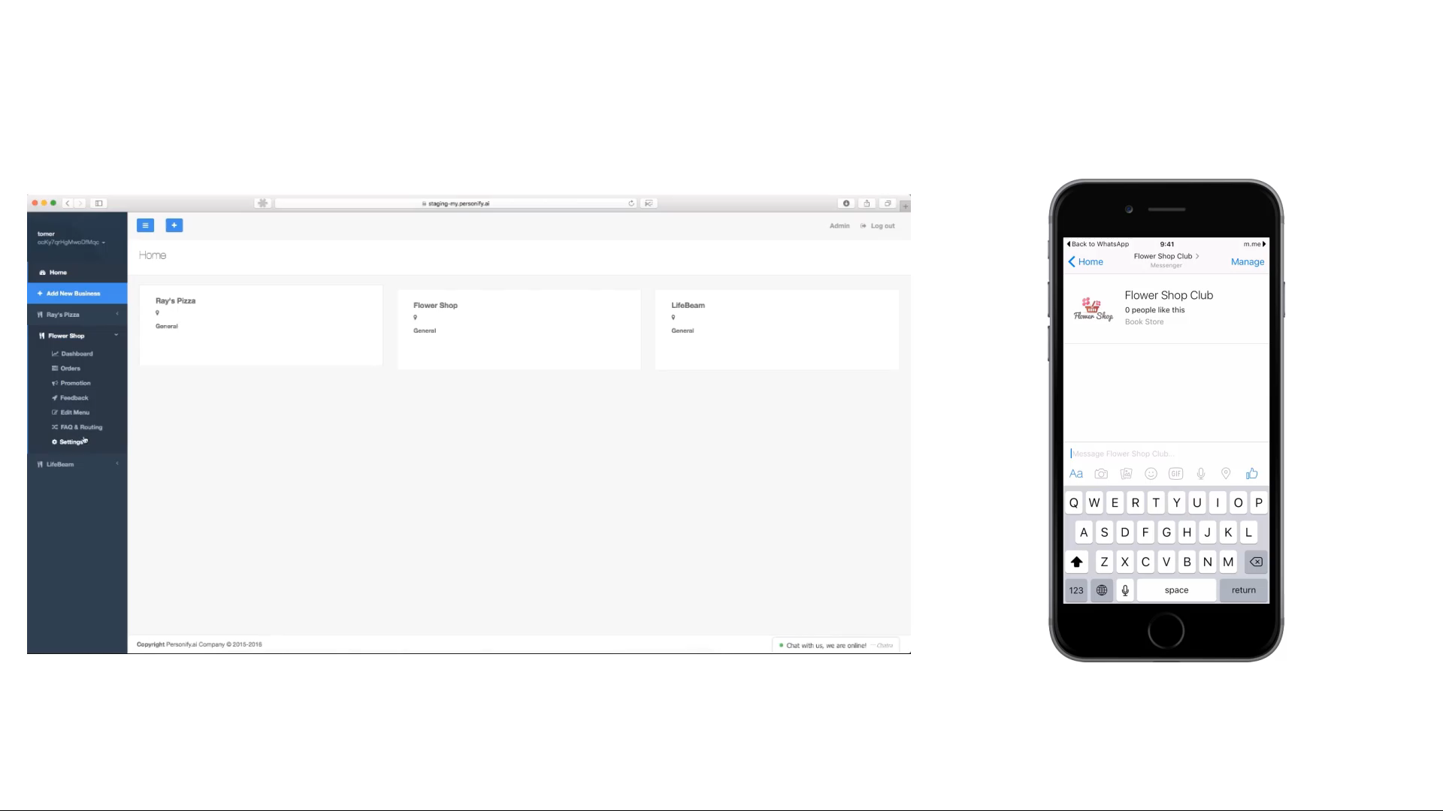
https://personify.ai/

Slide 8
주요 챗봇 플랫폼
ChattyPeople
Meokay
Smooch
Botsify
Beep Boop
Chatfuel
Facebook Messenger Platform
Telegram Bots
BotKit
FlwXO
https://www.entrepreneur.com/article/289788

Slide 9
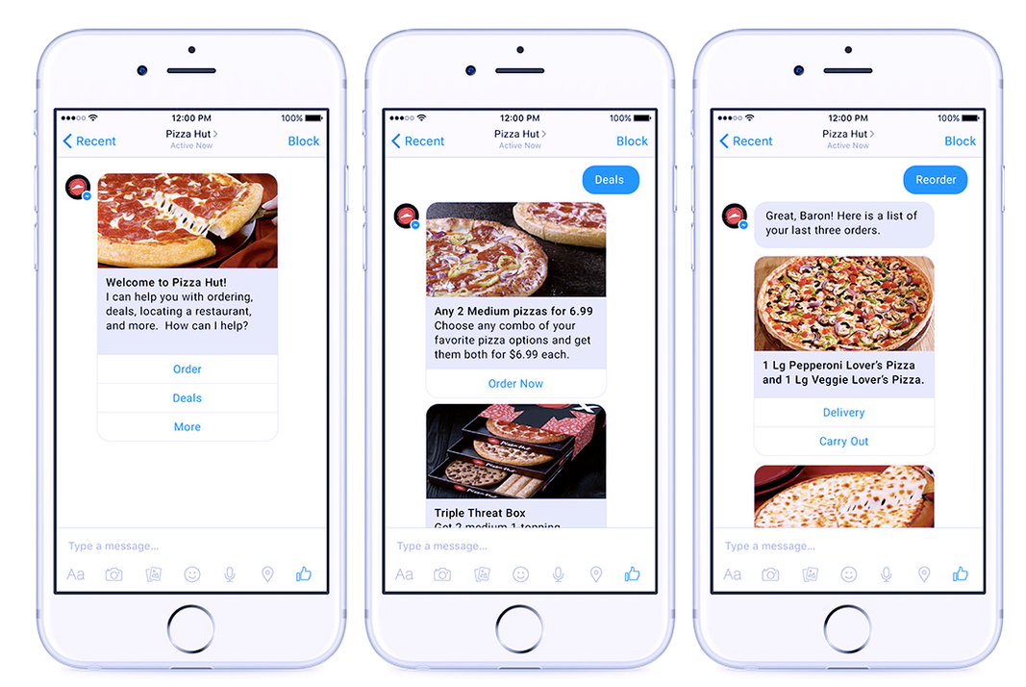
https://www.entrepreneur.com/article/289788

Slide 10
Chatbot.

Slide 11
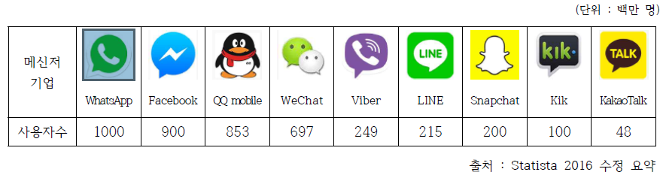
기업 현황 - 해외
출처 : Statista 2016 수정 요약

Slide 12
텍스트 기반 챗봇 주요 핵심 기술
관련 기술 | 주요내용
패턴인식 (Pattern Recognition) | 기계에 의하여 도형, 문자, 음성 등을 식별하는 것
자연어처리 (natural Language Processing) | 인간이 보통 쓰는 언어를 컴퓨터에 인식시켜 처리하는 일 정보검색 질의 응답, 시스템 자동 번역, 통역 등이 포함됨
시멘틱 웹 (Symantic Web) | 컴퓨터가 정보 자원의 뜻을 이해하고 논리적 추론까지 할 수 있는 차세대 지능형 웹
텍스트 마이닝 (Text Mining) | 비정형 텍스트 데이터에서 새롭고 유용한 정보를 찾아내는 과정 또는 기술
상황인식 컴퓨팅 (Context Aware Computing) | 가상공간에서 현실의 상황을 정보화하고 이를 활용하여 사용자 중심의 지능화된 서비스를 제공하는 기술.
출처 : 한국정보화진흥원, ‘모바일시대를 넘어 AI시대로’

Slide 13











CONNECTOR
STT / TTS (Speech to Text)
Bot Framework
NLP (Neutral Language Processing)
Text Mining
Cognitive

Slide 14
Microsoft Chatbot.

Slide 15



Slide 16
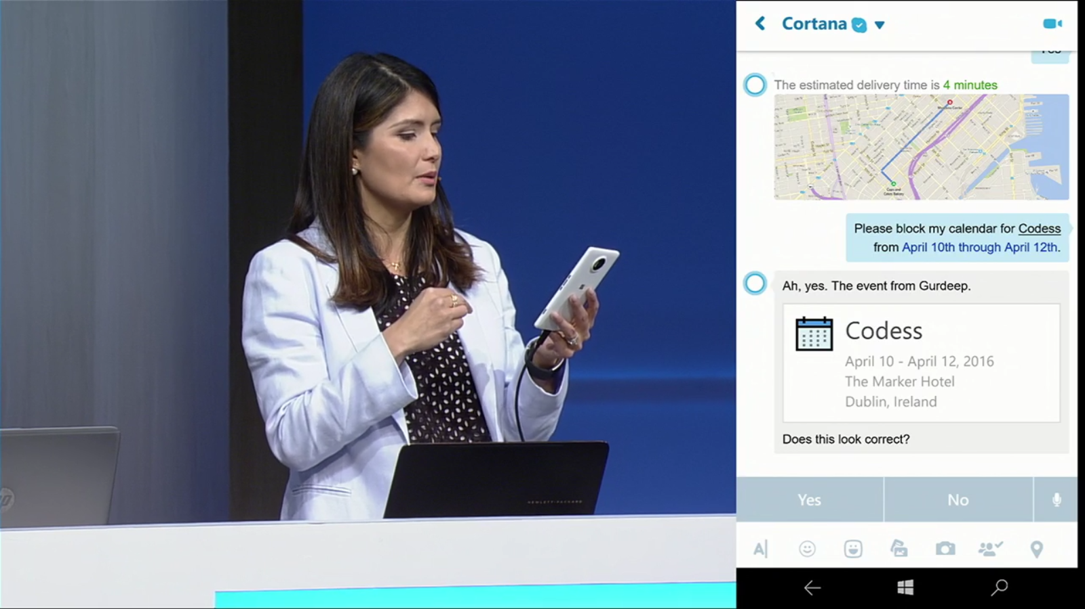

Slide 17
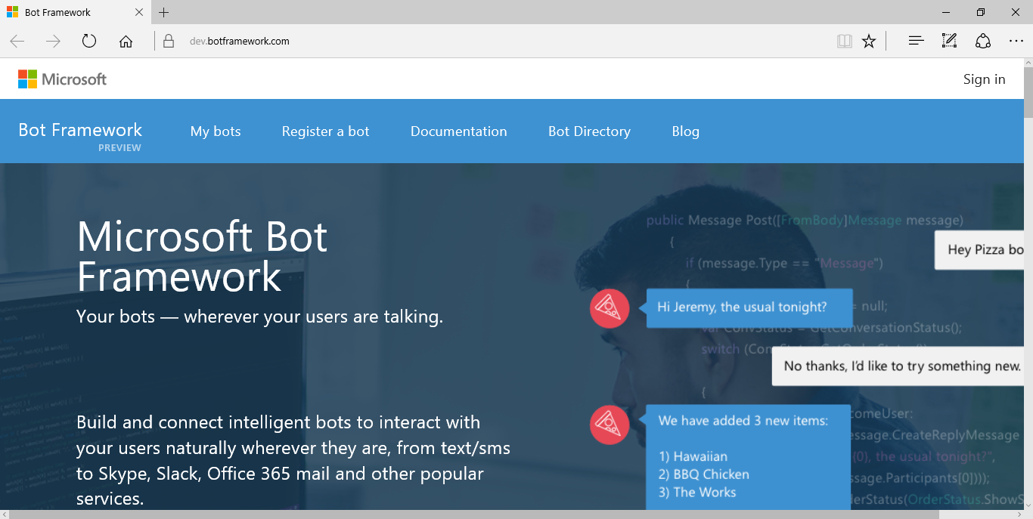
Microsoft Bot Framework
https://dev.botframework.com
C#, Node.js

Slide 18
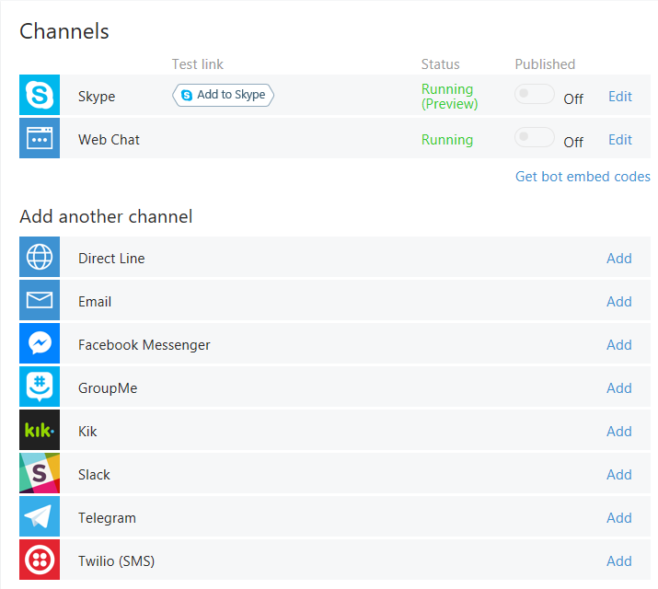
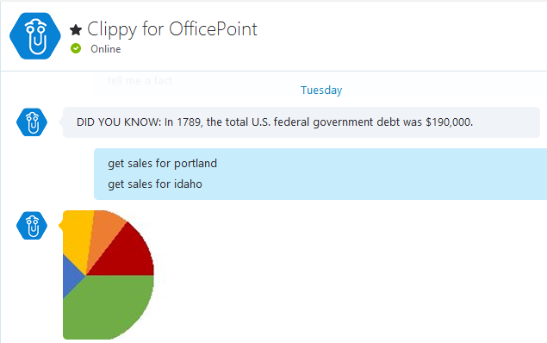
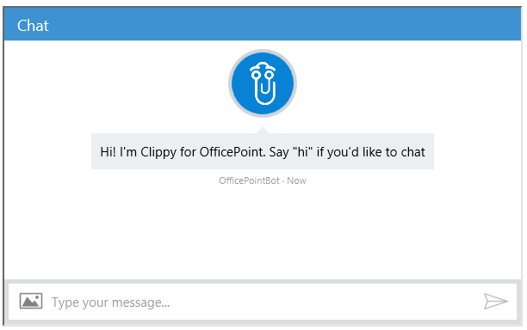
Microsoft Bot Framework
Skype,
Web, email, Facebook, GroupMe,
Kik,
Slack,
Telegram,
Twilio,
direct line app integration.

Slide 19

Connector Service Flow.
Channels
어챗웹
Web
Cloud (Microsoft Azure)
CONNECTOR
Chat Bot
(Bot Framework)
Web Service
HTTPS only
ASP.NET or Node.js
Routes messages
manages state
bot registration
Tracking
services (such as translation) and per-user and per-bot storage

Slide 20
DEMO Hello Bot

Slide 21
Code Name ‘Great Wall’

Slide 22
Connector, Activities & Messages
Connector | The Connector (or Connector Service) handles all communication, conversations, state, and authorization for all activities between a Bot and Users.
Activity | An Activity is a specific event that occurs between a Bot and Users, such as an actual message, or conversation notification.
Message | A Message is an overt (typically visible) communication between a Bot and Users, such as a User asking a question, or a Bot responding with a reply.

Slide 23
Connector Service Flow.
Channels
HTTPS
CONNECTOR
Chat Bot
(Bot Framework)
JSON
Web Service
HTTPS only
ASP.NET or Node.js
Routes messages
manages state
bot registration
Tracking
services (such as translation) and per-user and per-bot storage

Slide 24
Bot Connector messages
Your bot
Bot Connector
{
"type": "Message",
"id": "68YrxgtB53Y",
"conversationId": "DphPaFQrDuZDKyCez4AFGcT4vy5aQDje1lLGIjB8v18MFtb",
"language": "en",
"text": "You can say \"/order\" to order!",
"attachments": [ ],
"from": {
"name": "+12065551212",
"channelId": "sms",
"address": "+12065551212",
"id": "Ro52hKN287",
"isBot": false
},
"channelData": { SMS data here },
"botUserData": { your data here },
...
}

Slide 25
IDialog
Namespace: Microsoft.Bot.Builder.Dialogs.IDialog
private async Task MessageReceivedAsync(IDialogContext context, IAwaitable<object> result)
{
var activity = await result as Activity;
string message = string.Format("{0}을 주문하셨습니다. ", activity.Text);
await context.PostAsync(message);
context.Wait(MessageReceivedAsync);
}

Slide 26
DEMO Connector Activities & Messages

Slide 27
Types of Activities
Activity Type | Description
Message | Sent when general content is passed to or from a user and a bot
Conversation Update | Sent when the conversation's properties change, for example the topic name, or when user joins or leaves the group
Contact Relation Update | Sent when bot added or removed to contact list
Delete User Data | Send when user is removed from a conversation
Typing | Sent when a user is typing
Ping | Send when a keep-alive is needed

Slide 28
Activities Types
switch (activity.GetActivityType())
{
case ActivityTypes.Message:
message = string.Format("{0}을 주문 받았습니다. 감사합니다.", activity.Text);
reply = activity.CreateReply(message);
await connector.Conversations.ReplyToActivityAsync(reply);
break;
case ActivityTypes.ConversationUpdate:
message = string.Format("안녕하세요 만리장성 봇 입니다. 주문하실 메뉴를 입력해 주세요", activity.Text);
reply = activity.CreateReply(message);
await connector.Conversations.ReplyToActivityAsync(reply);
break;
case ActivityTypes.ContactRelationUpdate:
case ActivityTypes.Typing:
case ActivityTypes.DeleteUserData:
default:
break;
}

Slide 29
case ActivityTypes.ConversationUpdate:
message = string.Format("안녕하세요 만리장성 봇 입니다. 주문하실 메뉴를 입력해 주세요", activity.Text);
reply = activity.CreateReply(message);
await connector.Conversations.ReplyToActivityAsync(reply);
break;
case ActivityTypes.ContactRelationUpdate:
case ActivityTypes.Typing:
case ActivityTypes.DeleteUserData:
default:
break;
}

Slide 30
DEMO Type of Activities

Slide 31
Dialogs
Dialogs model a conversational process, where the exchange of messages between bot and user is the primary channel for interaction with the outside world. Each dialog is an abstraction that encapsulates its own state in a C# class that implements IDialog. Dialogs can be composed with other dialogs to maximize reuse, and a dialog context maintains a stack of dialogs active in the conversation. A conversation composed of dialogs is portable across machines to make it possible to scale a bot implementation. This conversation state (the stack of active dialogs and each dialog's state) is stored in the state service provided by the Bot Connector service, making the bot implementation stateless between requests. (Much like a web application that does not store session state in the web server's memory.)

Slide 32
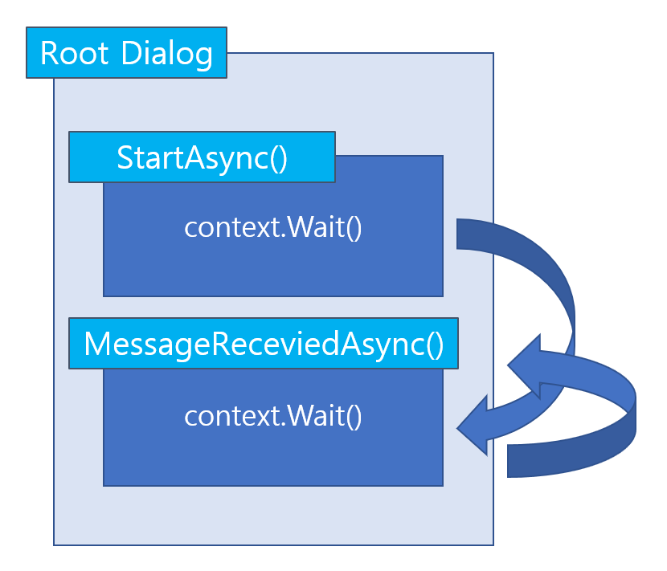

Slide 33
Dialog
Namespace: Microsoft.Bot.Builder.Dialogs
[Serializable]
public class FoodDialog : IDialog<object>
{
private string MENU;
public async Task StartAsync(IDialogContext context)
{
context.Wait(MessageReceivedAsync);
}
public async Task MessageReceivedAsync(IDialogContext context, IAwaitable<IMessageActivity> argument)
{
var activity = await argument;
ConnectorClient connector = new ConnectorClient(new Uri(activity.ServiceUrl));
string message;
message = string.Format("{0}를 주문하셨습니다. 감사합니다.", activity.Text);
// return our reply to the user
await context.PostAsync(message);
MENU += activity.Text + ",";
await context.PostAsync("주문내역:" + MENU);
context.Wait(MessageReceivedAsync);
}
}

Slide 34
public async Task MessageReceivedAsync(IDialogContext context, IAwaitable<IMessageActivity> argument)
{
var activity = await argument;
ConnectorClient connector = new ConnectorClient(new Uri(activity.ServiceUrl));
string message;
message = string.Format("{0}를 주문하셨습니다. 감사합니다.", activity.Text);
await context.PostAsync(message);
MENU += activity.Text + ",";
await context.PostAsync("주문내역:" + MENU);
context.Wait(MessageReceivedAsync);
}

Slide 35
메소드 | 설명
Call() | 다른 Dialog를 호출할 때 사용한다.
Done() | 현재 Dialog를 종료하고 상위 Dialog로 돌아간다.
Fail() | 현재 Dialog에서 예외를 발생하고 상위 Dialog로 돌아간다.
PostAsync() | 메시지를 출력한다.
Wait() | 대기 하고 있다가 다른 메소드를 실행한다.

Slide 36
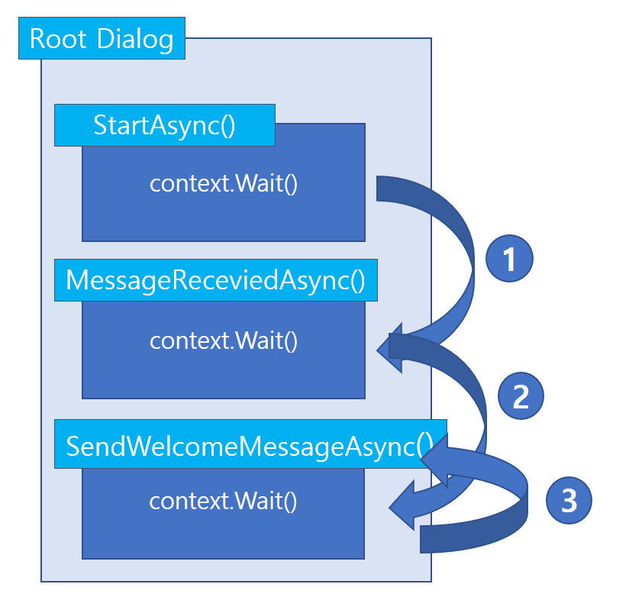

Slide 37
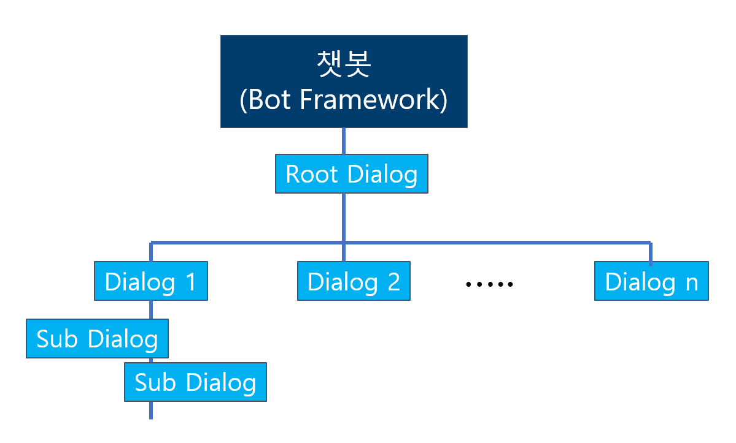

Slide 38
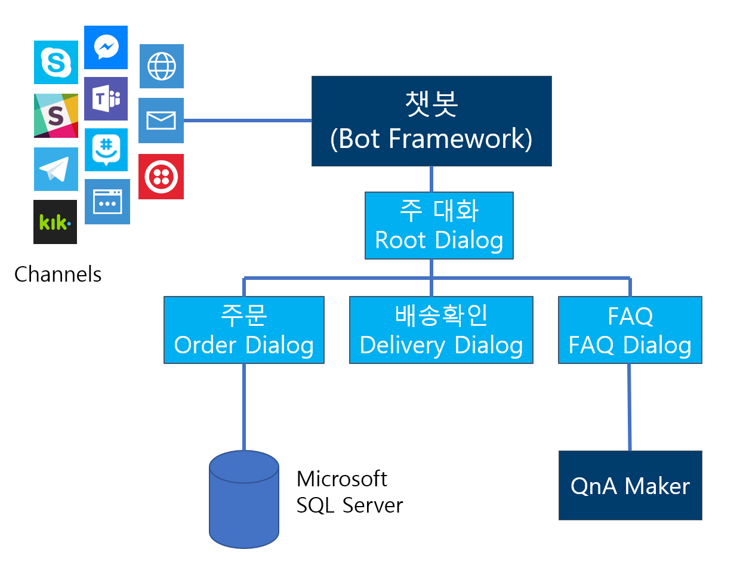

Slide 39
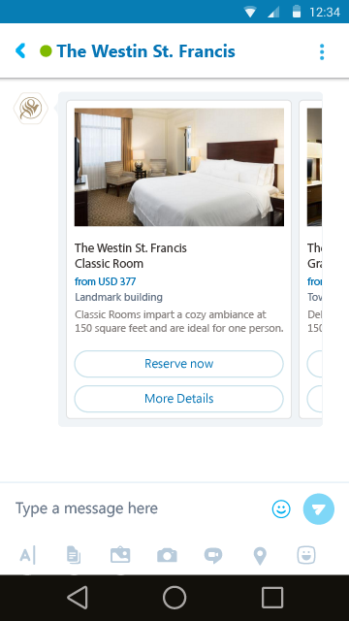
Attachments, Cards and Actions
Adaptive Card | 텍스트나 음성, 이미지, 버튼과 입력 필드을 조합해서 정의해서 사용할 수 있는 카드로 모든 메신저에서 지원되는 것은 아니다. 관련된 지원 목록은 https://docs.microsoft.com/en-us/adaptive-cards/get-started/bots#channel-status 에서 볼 수 있다.
Animation Card | 애니메이션 GIF나 짧은 동영상을 이용해서 동적인 반응을 보여 줄 때 사용되는 카드이다.
Audio Card | 오디오 파일을 재생할 때 사용되는 카드이다.
Hero Card | 일반적으로 하나의 큰 이미지와 하나 이상의 버튼과 텍스트가 포함되는 카드이다.
Thumbnail Card | Hero Card와 비슷하지만 썸네일 이미지가 포함된 카드이다.
Receipt Card | 영수증을 제공할 수 있도록 해주는 카드이다. 영수증에는 항목과 총 비용 그리고 VAT등을 표현할 수 있다.
SignIn Card | 사용자 로그인을 요청할 수 있게 해주는 카드. 텍스트와 로그인과정을 시작할 수 있도록 버튼 등이 포함 되어 있다.
Video Card | 비디오를 보여주고 재생할 수 있는 카드이다.

Slide 40
Card Actions
Action types | Content of value property
openUrl | URL to be opened in the built-in browser.
imBack | Text of message which client will sent back to bot as ordinary chat message. All other participants will see that was posted to the bot and who posted this.
postBack | Text of message which client will post to bot. Client applications will not display this message.
call | Destination for a call in following format: "tel:123123123123"
playAudio | playback audio container referenced by URL
playVideo | playback video container referenced by URL
showImage | show image referenced by URL
downloadFile | download file referenced by URL
signin | OAuth flow URL

Slide 41
DEMO Card and Action

Slide 42
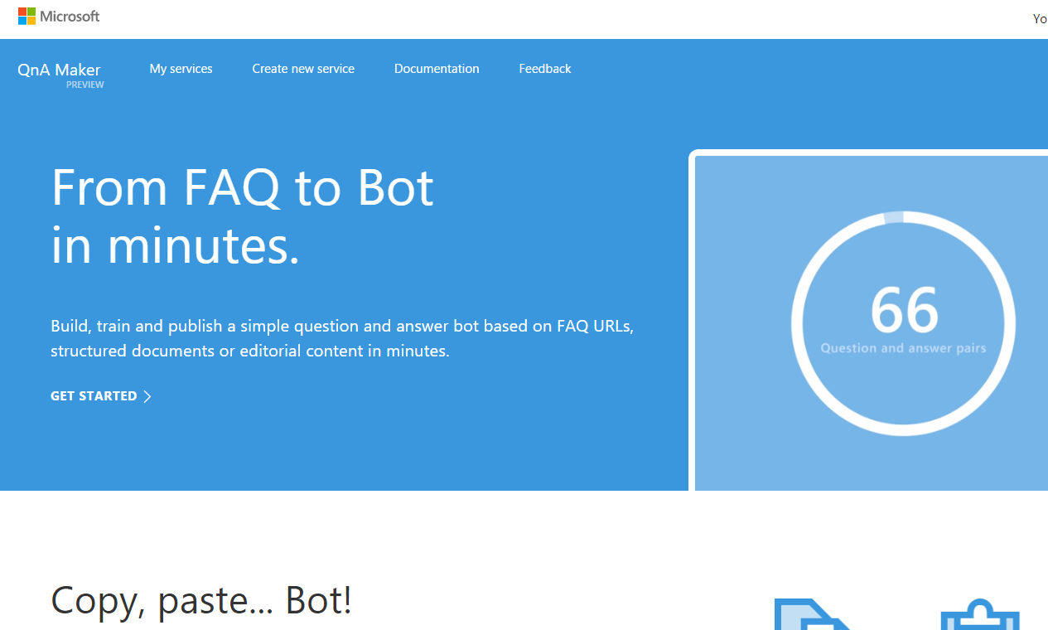

Slide 43
public class FAQDialog : QnAMakerDialog<string>
{
public override async Task NoMatchHandler()
public override async Task DefaultMatchHandler()
[QnAMakerResponseHandler(0.5)]
public async Task LowScoreHandler()
}

Slide 44
DEMO QnA Maker

Slide 45
Integrating Language Understanding Intelligence Services
LUIS
LUIS is part of Microsoft Cognitive Services offering and can be used for any device, on any platform, and any application scenario.
Essentially what Cortana uses on the backend for language and sematic interpretations
Provides “built in” logic that can be leveraged “out of the box”
Natural, adaptable, conversational intelligence
Model-based via intents and entities

Slide 46
Integrating Language Understanding Intelligence Services
학습
Intents
Entities
주문, 배달, 인사…..
메뉴: 자장면, 짬뽕, 탕수육… 크기: 보통, 곱빼기, 작은거, 큰거…
수량: 하나, 한그릇, 두그릇….

Slide 47
Your bot
Logic
Your conversation logic
Bot Builder SDK (Node.js + C#)
Web service
LUIS

Slide 48
한국어 지원
서비스
오픈소스
LUIS가 독보적
Word2Vector
KoNLPy

Slide 49
DEMO LUIS

Slide 50
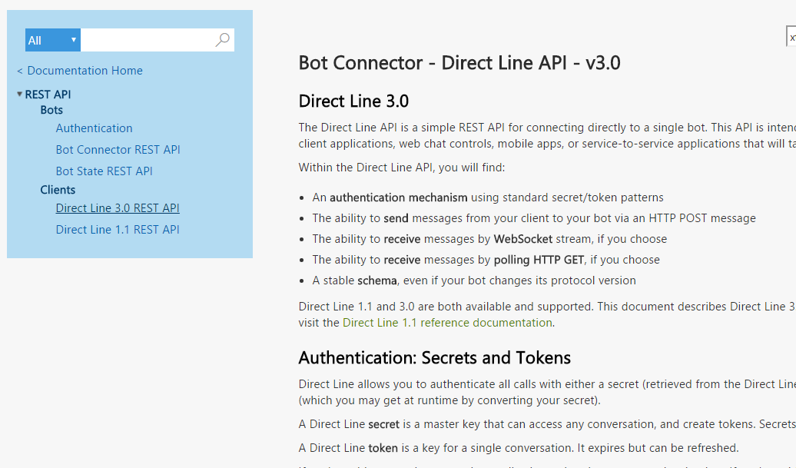
Direct Line API –V3.0
REST

Slide 51
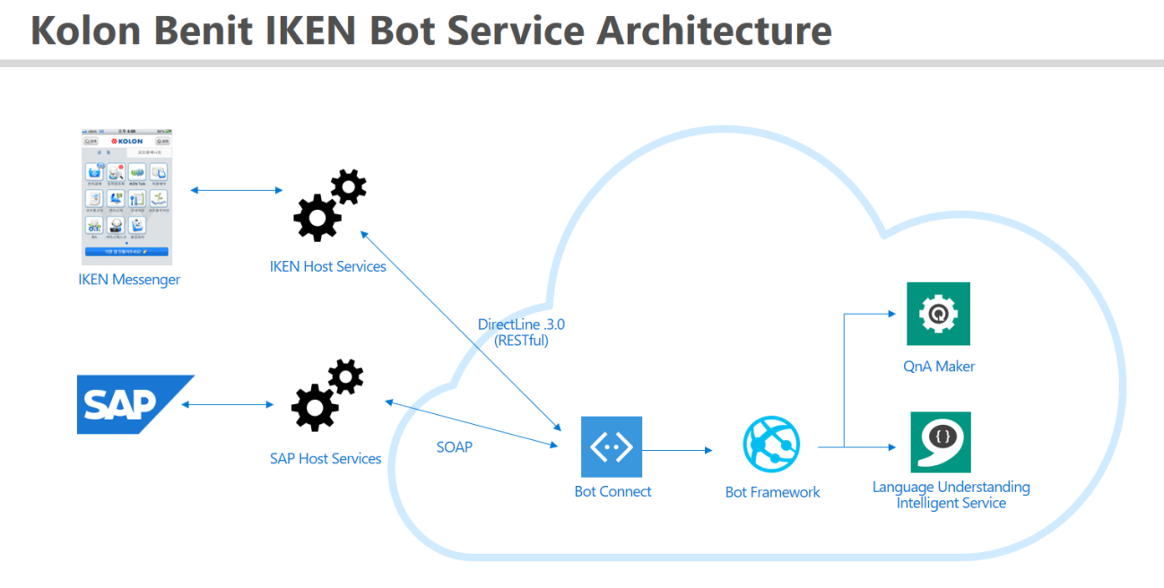

Slide 52
Bing image search
Speech API
Entity linking
Customer feedback analysis
Bing news search
Speech
Text to speech
Custom recognition (CRIS)
Forecasting
Language
Recommendation API
Machine Learning
Text analytics
Thumbnail generation
Cognitive Services APIs
Academic knowledge
Spell check
Web language model
Knowledge
Bing autosuggest
Computer vision
Vision
Emotion
Anomaly detection
Sentiment scoring
Search
OCR, tagging, captioning
Bing web search

Slide 53

Cognitive Services
microsoft.com/cognitive
Vision
Speech
Language
Knowledge
Search
Computer Vision
Custom Recognition
Bing Spell Check
Academic Knowledge
Bing
Web Search
Emotion
Speaker Recognition
Linguistic Analysis
Entity Linking
Bing
Image Search
Face
Speech
Language Understanding
Knowledge Exploration
Bing
Video Search
Video
Translator
Text Analytics
Recommendations
Bing
News Search
WebLM
Bing
Autosuggest
https://www.microsoft.com/cognitive-services/

Slide 54
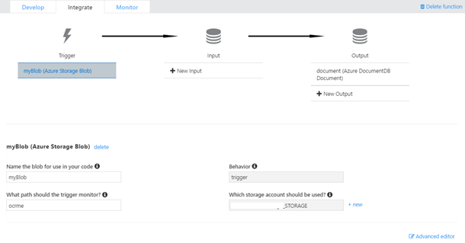
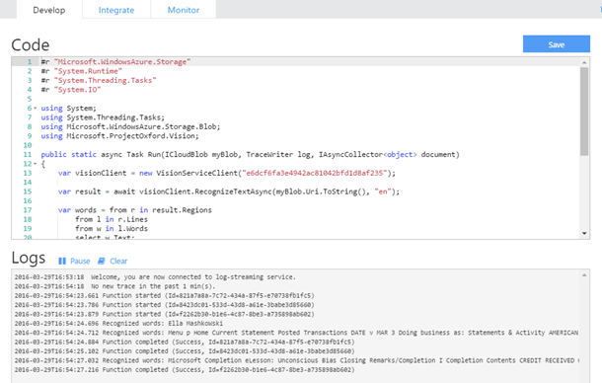
Azure Function

Slide 55
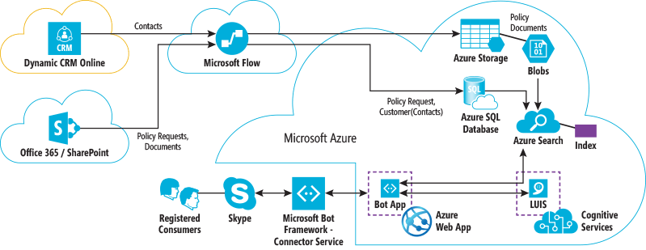
Azure Search

Slide 56
추천 도서
지금 쓰고 있습니다. Coming Soon Maybe 9월쯤..
도와주세요

Slide 57


Slide 58
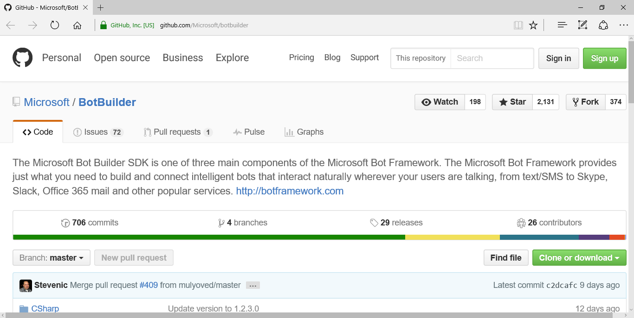
GitHub!
https://github.com/Microsoft/botbuilder

Slide 59
Tips & Tricks
Use an empty string for your Microsoft App Id and Password in development, but remember to change these to your actual values before you publishing into production.
Get used to understanding Lambda and “Fluid” concepts to make it easier to work with Dialogs, Forms and especially the concept of the Bot process “Chain”.
This session demonstrates storing and managing Bot State is a number of ways. Use what makes sense in your environment by uses these concepts purely as examples.
If the Microsoft Bot Emulator continues to give you authorization issues, try changing the port for your Bot Service in the Web tab of the project and redeploy.

Slide 60
DEMO Integration Language Understanding Intelligence Services

Slide 61
Putting it All Together
Putting it All Togethner
Add some more features to demonstrate LUIS integration
Walkthrough an example of using Attachments, Cards and Actions
Publishing your Bot
Using your Bot in a web chat and Skype

Slide 62
DEMO Putting It All Together

Slide 63
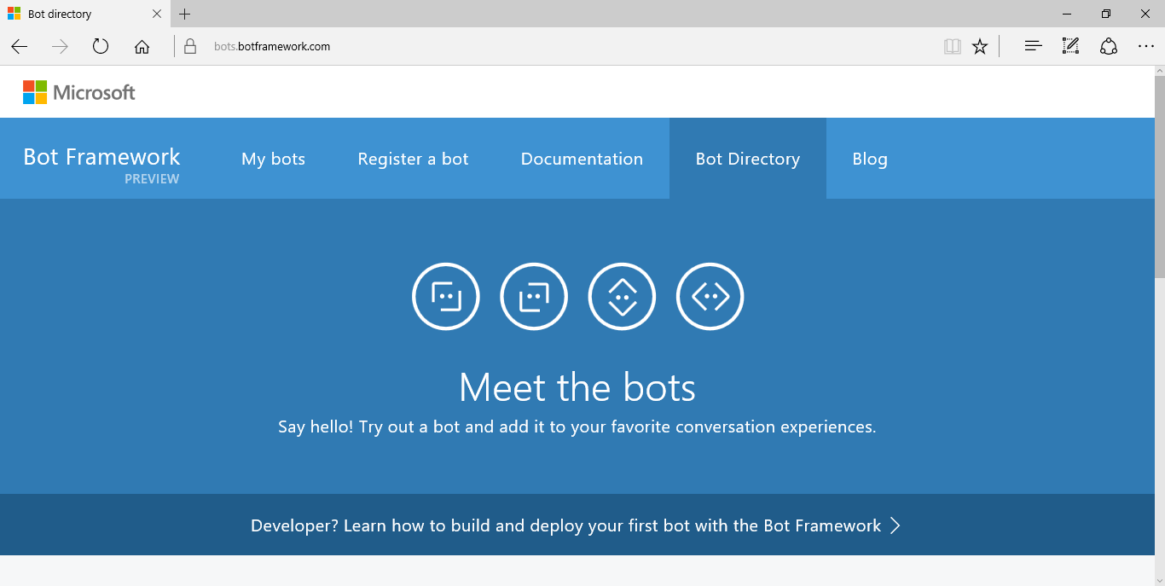
Bot Directory
https://bots.botframework.com/

Slide 64
Demo

Slide 65
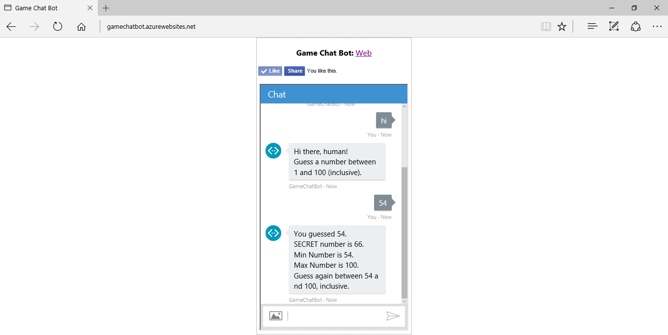
Game Chat Bot
http://gamechatbot.azurewebsites.net/

Slide 66
기업 현황 - 해외
업체 | 플랫폼 | 주요내용
페이스북 | Facebook Messenger | F8 2016에서 Facebook Messenger에 인공지능을 적용한 챗봇 공개. 40개 내외 업체들이 참여 예정
텐센트 | WeChat | 인공지능 기반의 챗봇 전환을 통해 메시지를 통해 대화 하며 호텔, 병원, 영화등의 예약 기능 제공
텔레그램 | Telegram | Bot API 공개로 개발자들에게 챗봇 개발 지원. 대화창에서 바로 이용이 가능한 Inline Bots를 추가
킥 | Bot Shop | 화장품/의류업체 등이 참여한 ‘봇샵(Bot Shop)’ 오픈을 통해 챗봇 서비스 제공
구글 | Allo | 인공지능 챗봇 기술 적용된 메신저 플랫폼 준비 중
출처 : Digieco, KB경영연구소, 언론기사 참조

Slide 67
Using Forms with FormFlow
Although Dialogs are the basic building block of a conversation, it’s difficult to create a “guided” conversation. FormFlow creates Dialogs and guides a User through filling in a “form” while providing help and guidance along the way.
Super smart based on enumerations and properties
Provide content for various scenarios, such and not understanding, clarification, and confirmations
Easily provide optional conversation paths based on previous choices

Slide 68
Connector Service Flow.
CONNECTOR
Chat Bot
(Bot Framework)
FormFlow
Web Service
HTTPS only
ASP.NET or Node.js
State
자장면
짬뽕
탕수육
.
.
.

Slide 69
FormFlow
Namespace: Microsoft.Bot.Builder.FormFlow
[Serializable]
public class FoodOrder
{
public FoodOptions? Food;
public LengthOptions? Length;
public static IForm<FoodOrder> BuildForm()
{
return new FormBuilder<FoodOrder>()
.Message("만리장성에 오신 여러분을 환영합니다.")
.Build();
}

Slide 70
FormFlow
Namespace: Microsoft.Bot.Builder.FormFlow
public enum FoodOptions
{
자장면, 짬뽕, 탕수육, 기스면, 란자완스
};
public enum LengthOptions { 보통, 곱배기};

Slide 71
DEMO Using Forms with FormFlow and Bot Deployment

